Slide 1
Multi-Objective Recommender
Systems
Presented by Mark Rosado and Samar Ashrafi
At Wentworth Institute of Technology
Fall 2022
Data Science course. Prof. Memo Ergezer.

Slide 2
Presentation Outline
1-Background
4-Modeling
2-Initial Findings
5-Findings
3-Preprocessing/Cleaning the Data
6-Conclusion

Slide 3
Introduction of Multi-Objective Recommender:
A competition hosted by OTTO, famous online-shopping in Germany
Goal:Predict e-commerce Clicks,cart addition, and orders
(predict aid for each session)

Slide 4
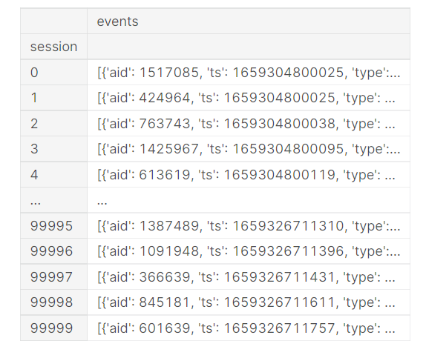

Slide 5
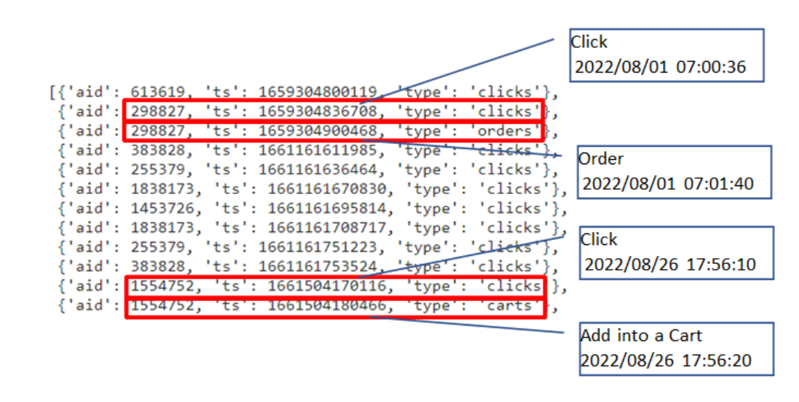

Slide 6
Initial Findings
Data
The data that is given to us contains more than 5,000,000 observations.
This became impossible to run the entire file at once with the devices we had.
The kaggle challenge provided multiple discussion topics and tips about the competition and anything related to it.
We utilized a forum called “[OTTO] Easy understanding for beginners.”
First Thoughts
We first utilized the Kaggle IDE but it is very limited compared to other IDEs.
We then switched onto Jupyter which provided better results.

Slide 7
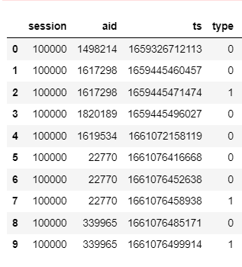
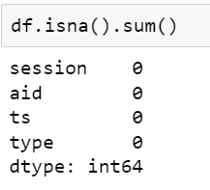
PreProcessing /
Cleaning Data
Converting json format to Pandas DataFrame
No Nan values to delete
Convert categorical Data to numeric Data
df.replace({'clicks': 0, 'carts': 1,'orders':2}, inplace=True)

Slide 8
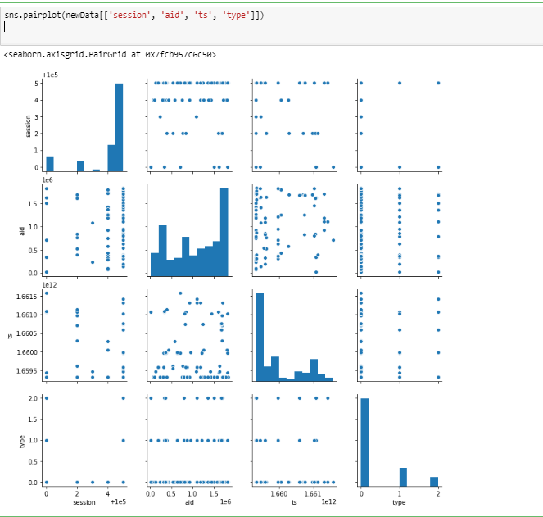
Plot the data to select best features:

Slide 9
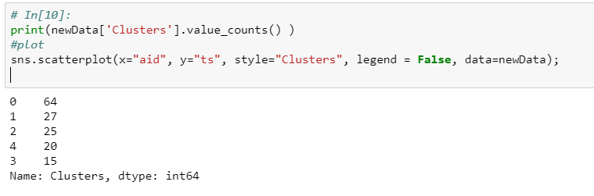
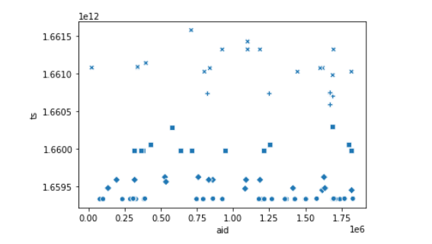

Slide 10
Modeling
4 different Machine Learning algorithms were used:
Supervised
K-Nearest Neighbors
Logistic Regression
Decision Trees
Unsupervised
K-means Clustering
Small samples were originally used so program would run quicker
Models were then chosen based on accuracy score to compare between others

Slide 11
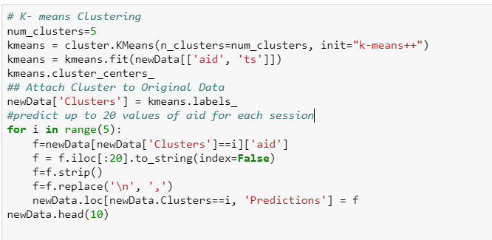
K-Means with aid,ts

Slide 12
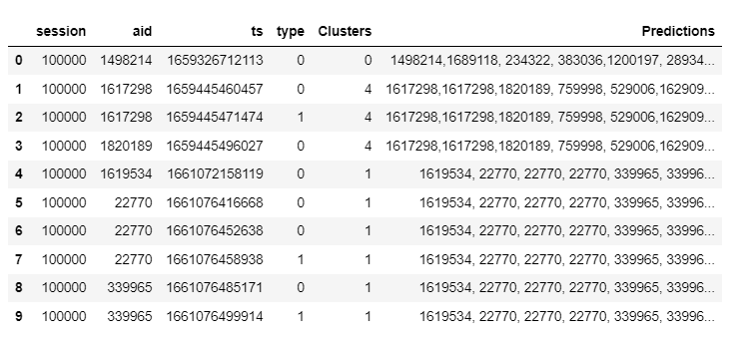
K-Means with aid,ts Results

Slide 13
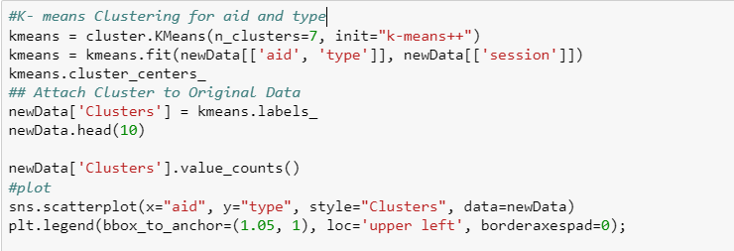
K-Means with aid,type

Slide 14
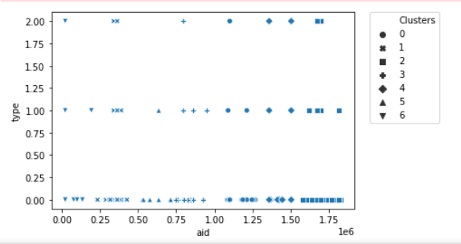
K-Means with aid,type Results

Slide 15
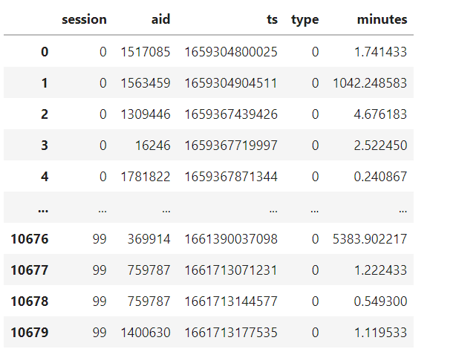
K-Means with All Feautures + additional feature

Slide 16
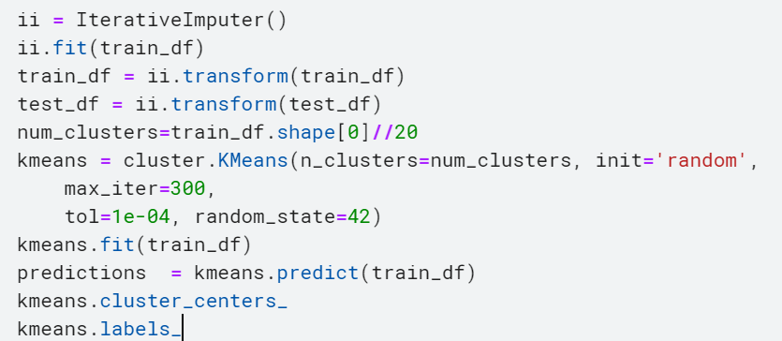

Slide 17
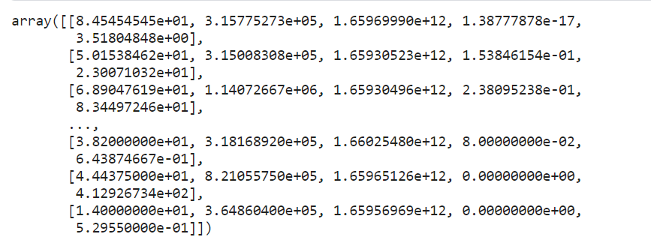

Slide 18
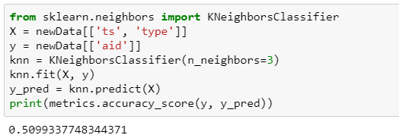
KNN

Slide 19
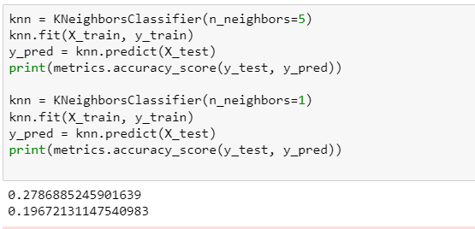
KNN

Slide 20
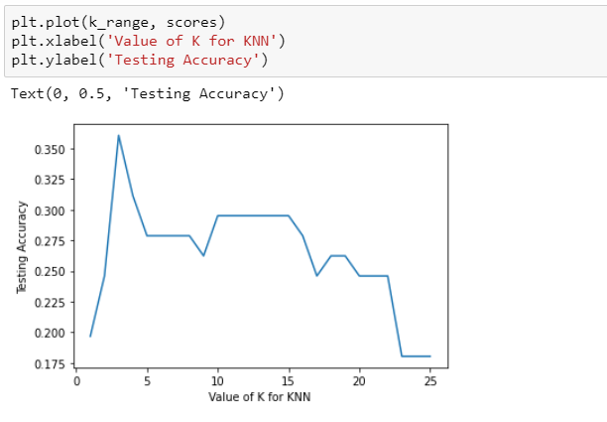
Select the best K

Slide 21
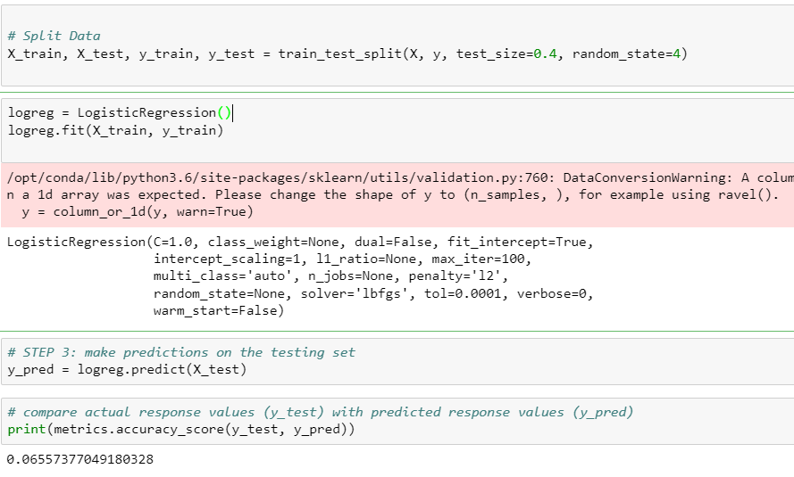
Logistic Regression

Slide 22
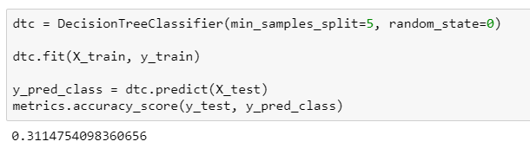
Decision Tree

Slide 23
Conclusion:
Ending Thoughts
Overall, KNN was the best model in terms of error rate with testing data
We can probably receive a better model if we are able to manipulate existing features
Due to the fact that the dataset was large we couldn’t properly include every data point but there might be ways to work with big data that we don’t know at the moment

Slide 24
Thank you!
Questions and Comments?

